Slide 1
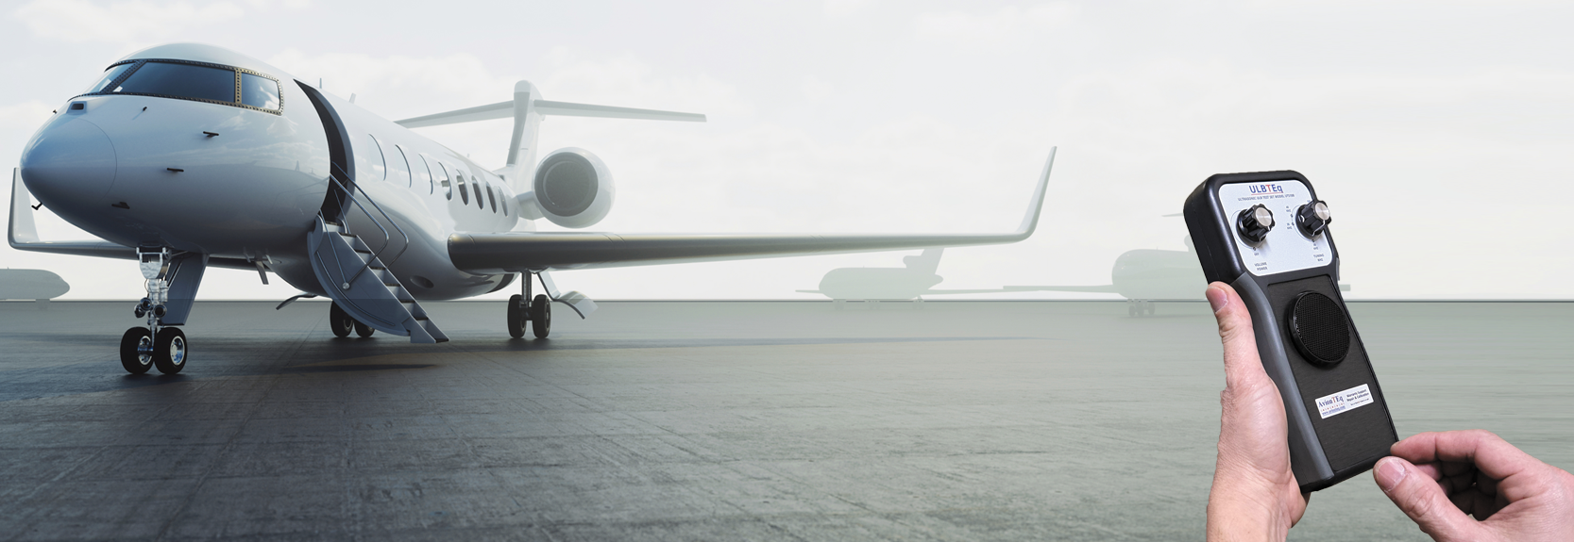
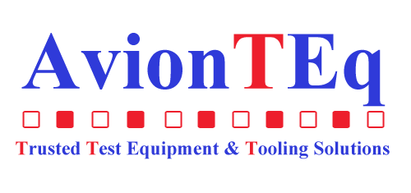
ULBTEq UTS100
by

Slide 2
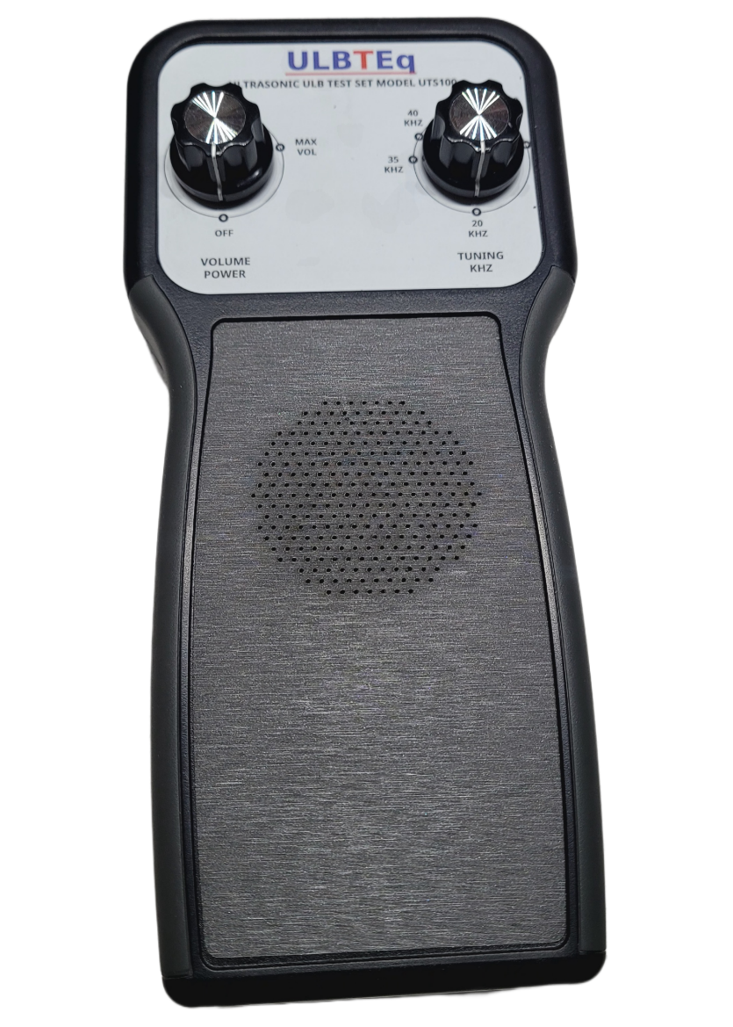
ULBTeq
Introducing…
UTS100
ULB TESTER

Slide 3
IMPORTANCE OF UNDERWATER LOCATOR BEACON TESTING
Search and Rescue Readiness
Regular testing ensures the functionality of these beacons, enabling swift and efficient search and rescue operations
in the event of an incident.
Enhanced Operational Safety
Regular ULB testing contributes to the overall safety of aviation operations. It minimizes the likelihood of equipment failure during critical moments, fostering a proactive approach to safety management.

Slide 4
THE CHALLENGE ....
There is a market gap for the availability of a low-cost, economical ULB tester designed for simple Go-No-Go testing.

Slide 5
ABOUT THE UTS100 ULB TESTER
The ULBTEq UTS100 tester is a hand-held device developed to detect ultrasonic frequencies between 20 KHZ and 100 KHZ.
Designed to test models DK100, DK120, DK130 & DK140 beacons

Slide 6
FEATURES
Concerned about running out of battery in the field? Fret not; the UTS100 comes equipped with a backup battery.
Portable, user-friendly, and convenient for cockpit use
Tested by a trusted lab , comes with one year warranty

Slide 7
UTS100
ULB TESTER
BENEFITS
COST EFFECTIVE
IN STOCK - READY TO SHIP
HANDHELD, EASY TO USE

Slide 8
Win a ULBTEq UTS100
ULB Tester!
VISIT US TO ENTER THE GIVEAWAY AT BOOTH 509

Slide 9
THANK YOU

